Slide 1



Court Mediation
Finland’s experience, 26Feb2021
Marjo Naapi
Judge, Mediator

Slide 2

2
Summary of the presentation
Mediation in Finland
Finnish Act on Court Mediation (663/2005)
Mediation specially in Family Disputes in District Courts
Experiences

Slide 3
3
Mediation in Finland
Court Mediation in Civil and Family Disputes
Victim Offender Mediation, Mediation in Criminal cases and smaller disputes
Peer Mediation in Schools and Kindergartens
Neighborhood Mediation
Street Mediation
Mediation of Consumer disputes
Mediation in Work communities, Workplace Mediation
Mediation in Labor disputes (between employers’ and employees’ unions)
Mediation in Family conflicts, Marriage act
Environmental Mediation
Post-processing of serious crimes and Mediation in prisons
International Peace Mediation

Slide 4
4
"Traditional litigation is a mistake that must be corrected... For some disputes trials will be the only means, but for many claims trials by adversarial contest must in time go the way of the ancient trial by battle and blood. Our system is too costly, too painful, too destructive, too inefficient for really civilized people.”
(Warren E. Burger, former Chief Justice of U.S. Supreme Court)

Slide 5
5
Act on mediation in civil matters and confirmation of settlements in general courts
In force originally January 2006 (new act in May 2011, after the Mediation directive 2008/52)
Applies to all civil matters (incl. family matters) in general courts
The objective of court mediation is an amicable resolution of the matter
Requires consent of all parties
Mediation may be commenced whether there is a matter pending in court or not; separate application/referral, joint request/by one party alone/judge’s initiative
The court decides on the commencement of mediation

Slide 6
Act on mediation cont. 6
A judge acts as a mediator (never in his/her own cases, the mediator shall not adjudicate in the same case, incl. confidentiality)
Judges trained to work as mediators (CEDR-based training)
Possible to ask for a certain judge to mediate (based on the trust)
Voluntary, facilitated, structured (phases, techniques, tools), not conciliation, different procedure, different roles
Possible to use an expert to assist in mediation
The settlement may be confirmed in court, enforceable as such

Slide 7
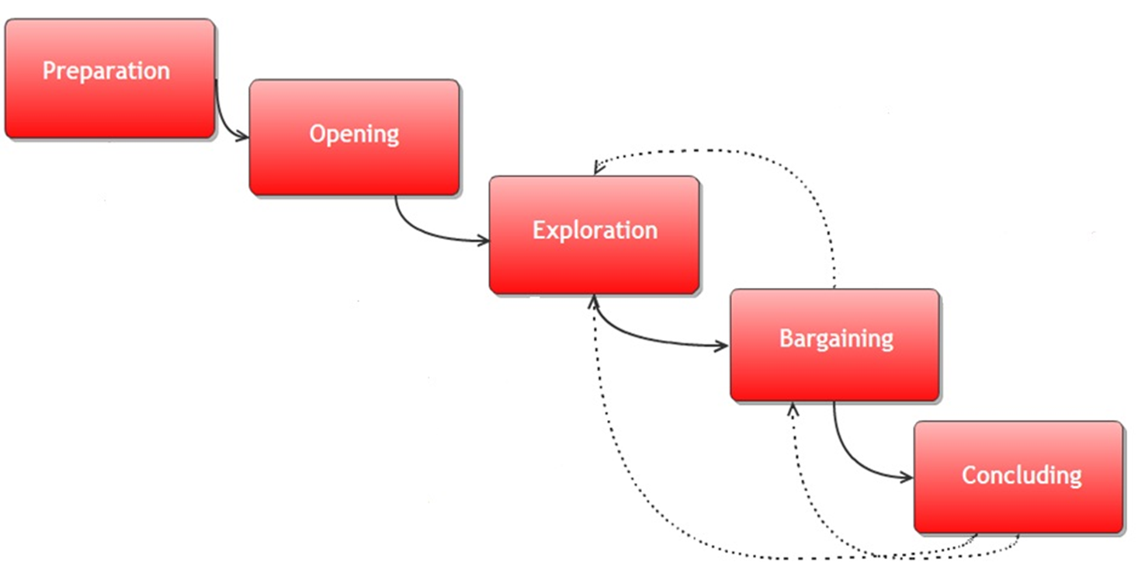
Example_Phases of mediation, 5 steps 7

Slide 8
8
Mediation in Family Disputes (in courts)
Based on the abovementioned Act on mediation...
Mediation should be carried out and the settlement confirmed so that the interests of the child are safeguarded and the provisions in the law concerning the custody of a child are taken into account
Objective to increase settlements in cases where children are involved: co-mediation in courts, judge as a mediator and a psychologist or an experienced social worker as a co-mediator, both trained as mediators

Slide 9
Mediation in Family Disputes cont. 9
Mediation as an alternative to a long and often strenuous trial
A special service that parents may use
Questions that may be brought up
  Custody of the child
  Living arrangements
  Visiting rights
  Maintenance of the child
  Other matters concerning child’s everyday life that cannot be handled in a trial

Slide 10
Mediation in Family disputes cont. 10
The goal is an amicable and a durable agreement in the best interest of the child
Mediation with expert assistance to ensure that questions that are essential with the regard to the best interests of the child are handled and the settlement reached is in the best interests of the child
Based on discussions with both parent present, caucus sessions, and possibly also with the child
Always based on voluntariness

Slide 11
Mediation in Family disputes cont. 11
A judge-mediator acquainted with family matters acts as a mediator (never in his/her own cases, the mediator shall not adjudicate in the same case)
Always co-mediation with an expert in parenting and child development matters, a psychologist or an experienced social worker
Multi-professional team to support the parents in solving both the legal and the psychological problems
Voluntary, facilitated, structured
The agreement can be confirmed in court by the mediator, valid similarly to a court decision and enforceable as such

Slide 12
Mediation in Family disputes cont. 12
Costs of the expert paid by the state (free for the parties)
No extra costs for using mediator, judge’s duty to mediate in his/her office (just court fee 250 euros, if not free legal aid)
Training of judges and experts to act as mediators, co-mediation, also cross scientifical training (child development, multicultural, diversity, parenthood etc.)
Training organized by the National Courts Administration in cooperation with the Judicial Training Board

Slide 13
13
Mediation works:
whenever the parties communicate, at least at a minimum lever
in cases in which the parties are somewhat dependent on each other, or are in any relationship - family, neighborhood, work or business
if the dispute that is suitable for mediation gives space for an agreement which is beneficial to both parties
.

Slide 14
14
Mediation might not be appropriate:
(possible obstacles)
if the parties absolutely do not communicate together or just want to beat the other
at the stage of "all-out war" between the parties and maximum emotional stress
in cases where one party has serious problems with alcohol or drugs and is not under the treatment
if one of the parties suffers from severe mental health problems or acts in an aggressive way, possible criminal offences or abuse
in the case of passivity party that wants only to give up their rights
if one party does not want to provide the information connected with the dispute
.

Slide 15
Benefits of mediation 15
Saved time:
mediation can be arranged quickly
mediation is faster, usually completed in one day, often in a few hours, family matters usually take longer, even more than one meeting (temporary agreements)
Lower costs:
possibility to avoid costs of preparing and participation in a trial, legal fees etc.
liability to pay costs of the adverse party
human costs, effects of litigation on life, health, ability to move on
(saved) time is money

Slide 16
Benefits cont. 16
Flexibility:
customized process for different kinds of cases
possibility to decide how to settle the dispute
control over the outcome
creative agreements
Less stress:
informality
safe forum, less frightening and intimidating than court session
parties are steered to cooperate and work together
Forward-looking, focus on the future:
compared to trial
prevents future disputes
enables later coexistence of parties

Slide 17

Benefits cont. 17
Satisfaction and finality:
satisfaction with the result
commitment
enforcement rarely needed
ownership of the dispute, control of their own conflict
win-win results
participation and experience of justice
satisfaction with the process
finality of the outcome
avoiding possible spiral of trials
Confidentiality:
privacy of the mediation
confidentiality of the outcome
what comes up in mediation is inadmissible if the case goes to trial

Slide 18
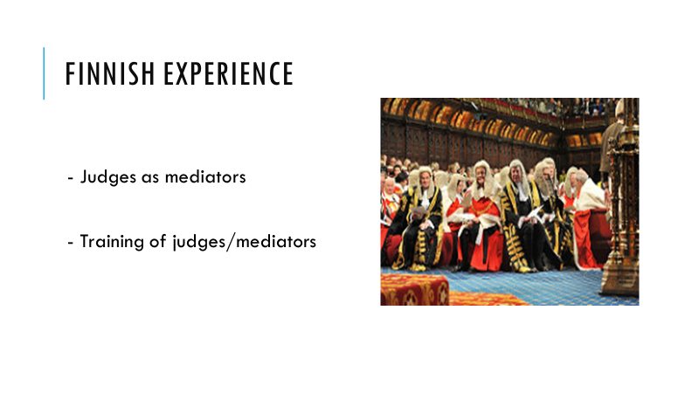
Benefits for courts 18
saves resources, proven reduction of courts’ caseload (number of cases and hearings, writing time of reasonings etc.), eases the workload of a judge
shorter cycle of cases, shortens the average time cases are pending in courts
can end constant never ending litigation (spiral of trials)
Courts as service providers?
who are we for?
belief in the procedure
support from the management

Slide 19
Experiences 19
More than 50 % of all family law cases referred, today more than 50 % of all direct applications
More than 80 % of civil cases settled, over 60 % of the family disputes end up to an agreement
In general court users’ experiences are very good, feedback
Challenging, but judges commonly find it very rewarding, work supervision
Very important to distinct the roles, judge/mediator, not conciliation, different procedures, mediation follows a certain structure, certain techniques and tools, parties must know and understand the procedure their case is handled in
Two equal experts working together found very fruitful
Facilities, calendars, preparation etc.
Tools; active listening, caucuses, temporary agreements, discussions with the child etc.

Slide 20
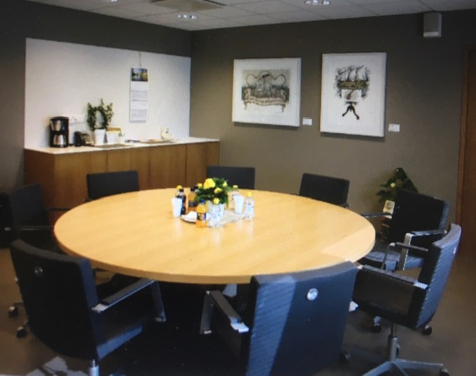
20

Slide 21
21
Experiences cont.
Judges acting as mediators for more than 14 years
Still acting as judges in other civil cases or as criminal judges in their courts, but not in the same cases
Confidentiality (incl. collegial confidentiality)
Experience as mediators help judges in their work also as a judges (without mixing the roles)
Absolutely better for parties and the families and especially for the children than the court proceedings
Also better for the courts, better for the social field; saving resources, shorter cycle of cases, eases the workload

Slide 22
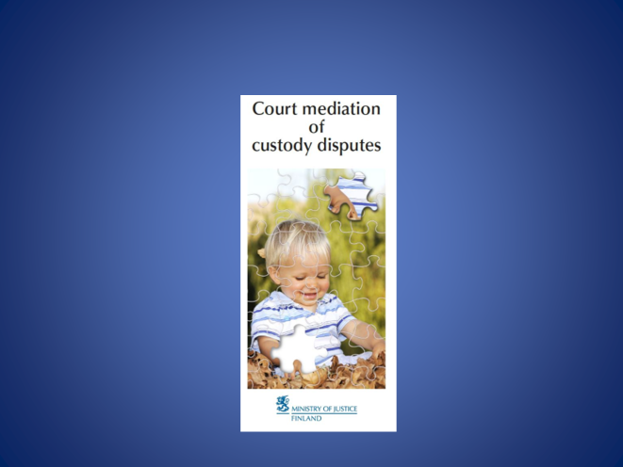
22

Slide 23
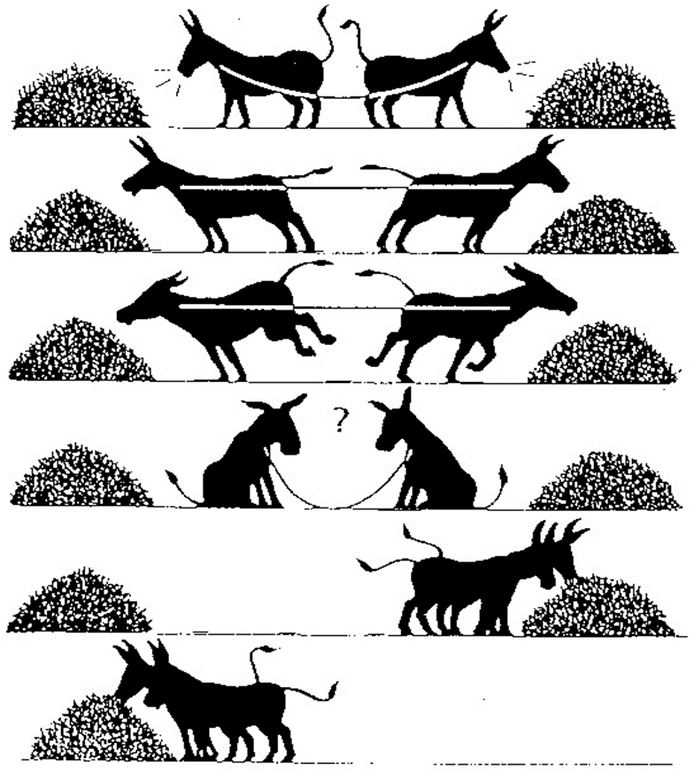
23

Slide 24
Links: 24
https://oikeus.fi/tuomioistuimet/en/index/asiat/perheasiat/lapsenhuoltoasuminenelatusjatapaaminen/expert-assistedmediationofcustodydisputesatthedistrictcourt.html
https://oikeus.fi/en/index/laatikot/perheasiatoikeudessa.html
file:///C:/Users/03084516/Downloads/469-1283-1-PB.pdf
https://www.utrechtlawreview.org/articles/abstract/10.18352/ulr.469/
https://www.springer.com/gp/book/9783319730189
https://thl.fi/en/web/thlfi-en/services/special-government-services-in-social-welfare-and-health-care/mediation-in-criminal-and-civil-cases

Slide 25

Thank you!
This presentation was produced with the financial support of the European Union. Its contents are the sole responsibility of PRAVO-JUSTICE and do not necessarily reflect the views of the European Union.

